Slide 1
DSP Part 2

Slide 2
The basic DSP framework is composed of an input signal, a system response, and an output signal. The DSP system is linear if H is linear.
$$x\left(n\right)$$
Input Signal
𝑥(𝑛)
Input Signal
$$H\left(n\right)$$
System
𝐻(𝑛)
System
$$y\left(n\right)$$
Output Signal
𝑦(𝑛)
Output Signal

Slide 3
Some examples of linear and non-linear systems
Linear systems
Non-Linear Systems
Electrical circuits composed of resistors
Integration of a continuous function
$P=RV^{2}$, the radiant energy emission of a hot object depending on its temperature
𝑃=𝑅𝑉^2, the radiant energy emission of a hot object depending on its temperature
Radioactive Decay of a compound as a function of time

Slide 4
The Importance of Linear Systems in DSP
In DSP, linearity allows us to break a complicated problem into many easy ones to solve. Divide-and-Conquer Principle in action.

Slide 5
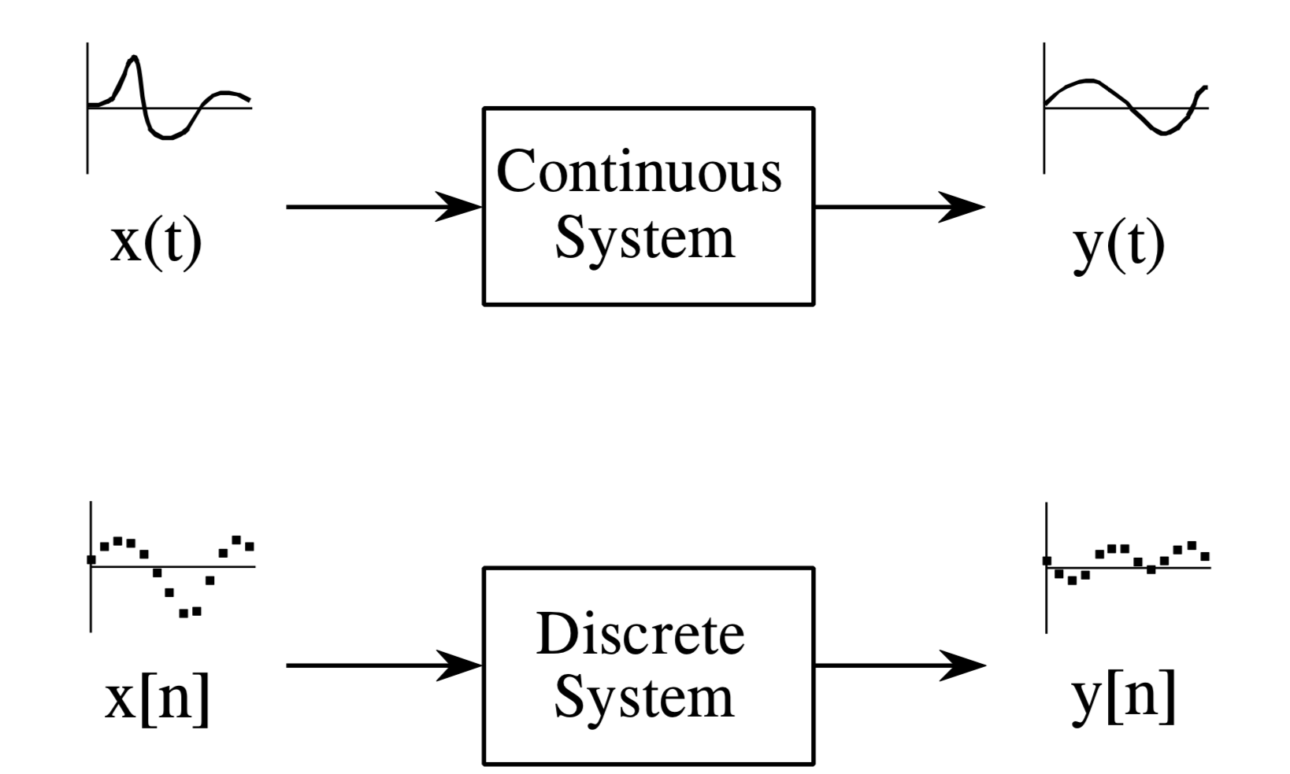
Most DSP techniques are based on a Divide-and-Conquer Strategy called Superposition.
In Superposition, the signal is:
Broken into simple components
Each component processed individually
Results are reunited
The system must be LINEAR for Superposition to be possible.
From the Book: The Scientist & Engineer's Guide to Digital Signal Processing

Slide 6
Illustration of Decomposition and Synthesis of linear signals.
Decomposition
Synthesis
From the Book: The Scientist & Engineer's Guide to Digital Signal Processing

Slide 7
Two main techniques of signal processing:
Convolution and Fourier analysis
Both techniques are based on:
Decomposing signals into simple additive components
Processing the components in some useful manner
Synthesizing the components into a final result

Slide 8
Convolution and Its Properties
Convolution is the principle of combining two signals to form a third signal that expresses how the shape of one is modified by the other. This is the cornerstone of DSP. Forget everything if you wish, but remember this!

Slide 9
The Dirac Delta Function or Unit Impulse Function holds the value of 1 at one point, and 0 everywhere else.
Paul Dirac British Theoretical Physicist, 1902 - 1984
Courtesy: Wikipedia
https://en.wikipedia.org/wiki/Dirac_delta_function

Slide 10
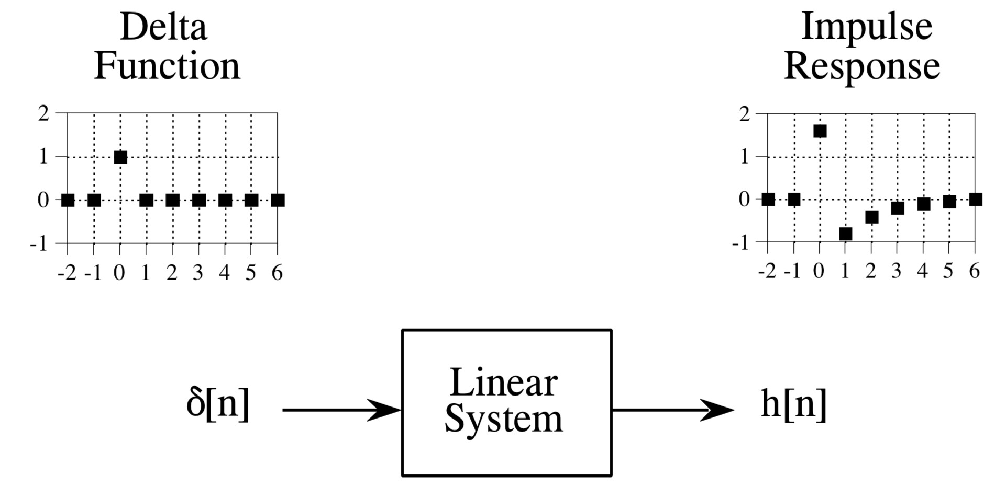
The Impulse Response is the signal that exits a system when a Delta function (unit impulse) is the input.
From the Book: The Scientist & Engineer's Guide to Digital Signal Processing

Slide 11
With linear systems, convolution is used to describe the relationship between: the input signal, the impulse response, and the output signal.
Input Signal
x[n]
Linear System:
Impulse Response
h[n]
Output Signal
y(n)
Convolution is an operation on two functions to produce a third function that expresses how the shape of one is modified by the other.

Slide 12
An Example of Convolution

Slide 13
Do you remember the definition of the Convolution? Can you observe it here?
Low Pass Filter
Smoothing effect of the Low-Pass Filter
The High-Pass allows only the more rapidly changing sine waves to go through.
High-Pass Filter

Slide 14
Why is Convolution so important?
Convolution is a the basis of many DSP techniques
A linear system is completely characterized by its impulse response, which follows convolution rules.
Digital filters are created by designing an appropriate impulse response.
Example:
Enemy aircraft are detected with radar by analyzing a measured impulse response.
Example:
Echo suppression in telephone calls is accomplished by creating an impulse response that counteracts the impulse response of the echo.

Slide 15
Digital Filters

Slide 16
What are Digital Filters used For?
Digital filters are mainly used for two general purposes: Signal Separation and Signal Restoration

Slide 17
Digital filters are used for two general purposes:
Signal Separation
Signal Restoration
Example: A baby's heart (EKG) in the womb.
The breathing motion and heartbeat of the mother will corrupt the baby’s heart EKG.
Example: Audio recording
The audio may be filtered to better represent the sound as it actually occurred.

Slide 18
How is the information represented in signals? For naturally occurring signals, information is usually represented in the time domain, and information represented in the frequency domain.
Time Domain
Frequency Domain
Fourier Transform
This is how crucial the Fourier Transform is! ☺

Slide 19
What does the information in the time domain describe? When represented the time domain, the information describes when something occurs and what the amplitude of the occurrence is.
Sensor measuring atmospheric pressure, temperature
Voltage as a function of time
Intensity of the light output from the sun

Slide 20
What does the information in the frequency domain describe? The information represented in the frequency domain tends to be a more indirect. Think of the notion of frequency, phase, and amplitude.
Movements of our planets
Sound produced by a ringing bell
By measuring the frequency, phase, and amplitude of this periodic motion, information can often be obtained about the system producing the motion.

Slide 21
Let’s revisit the notion of time domain and frequency domain
Time Domain
Frequency Domain
Fourier Transform
This is how crucial the Fourier Transform is! ☺

Slide 22
Good performance in the time domain results in poor performance in the frequency domain, and vice versa.
Time Domain
Frequency Domain
Example: If you are interested in removing noise from an EKG signal, then the frequency response is of little concern.
Example: If you are interested in designing a digital filter for a hearing aid, then the frequency response is all very important.

Slide 23
What is a filter?
A digital filter separates the signal’s x(n) spectrum into frequency components that will be passed and frequency components that will be blocked. (Low-Pass vs. High Pass)
In DSP, a digital filter is a system that performs mathematical operations on a sampled, discrete-time signal to reduce or enhance certain aspects of that signal.

Slide 24
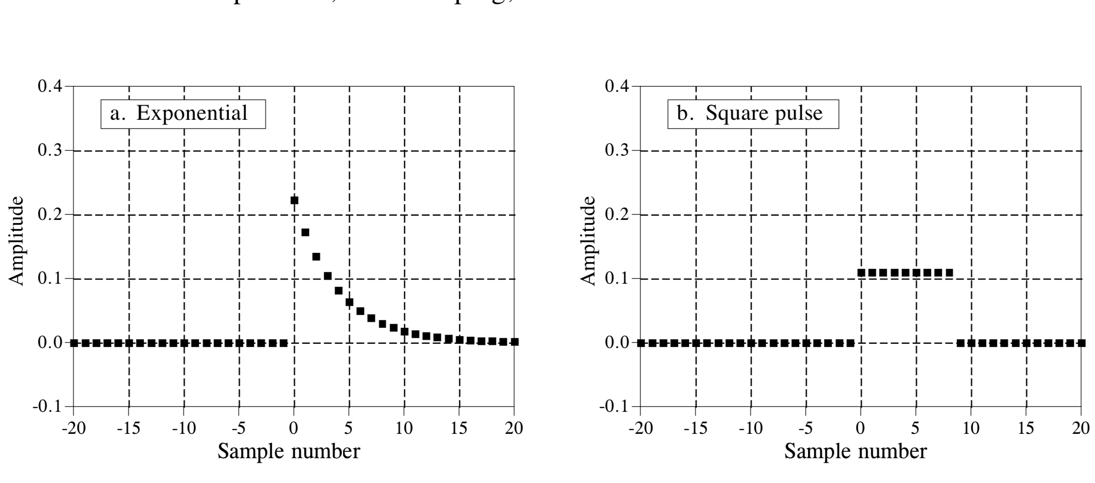
Low-Pass Filters are composed of a group of adjacent positive points. They remove high-frequency components to give a smooth output signal. Here are some examples.
From the Book: The Scientist & Engineer's Guide to Digital Signal Processing

Slide 25
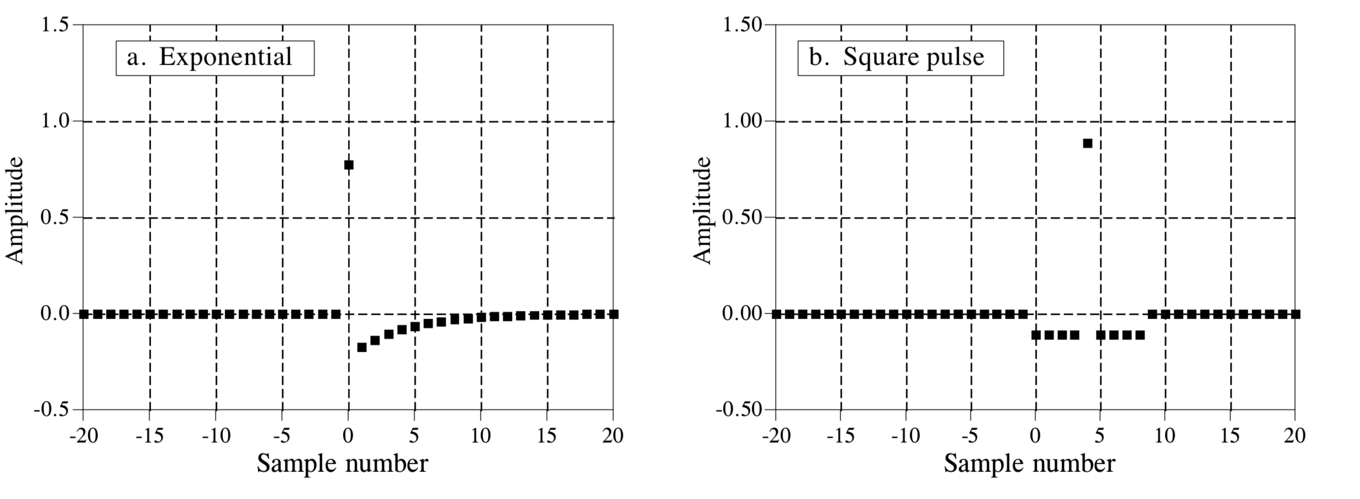
Examples of High-Pass filters (blocking low frequencies and passes high frequencies)
From the Book: The Scientist & Engineer's Guide to Digital Signal Processing

Slide 26
Two common frequency domain representations of low-pass and high pass filters:
Passband: frequencies that are passed
Stopband: contains those frequencies that are blocked.
Transition band is between.
Fast Roll-off: means that the transition band is very narrow.
Cutoff frequency (-3dB Frequency): Division between the passband and transition band.

Slide 27
Parameters for evaluating frequency domain performance. The frequency responses shown are for low-pass filters.
Do you remember the purpose of these filters?
To allow some frequencies to pass unaltered, while completely blocking other frequencies.
Three parameters are important:
(1) Roll-off sharpness, shown in (a) and (b)
(2) Passband ripple, shown in (c) and (d)
(3) Stopband attenuation, shown in (e) and (f).

Slide 28
An Example of filtering in X-Ray Computed Tomography: The High-Pass Filter, or the Sharpening Filter picks up sharp edges within the image and tends to ignore flat areas.
Left: Unfiltered Image (Blurry Image)
Right: Filtered Image using a High-Pass Filter
From Interactive Radiology Physics by Mark Hammer
http://xrayphysics.com/index.html

Slide 29
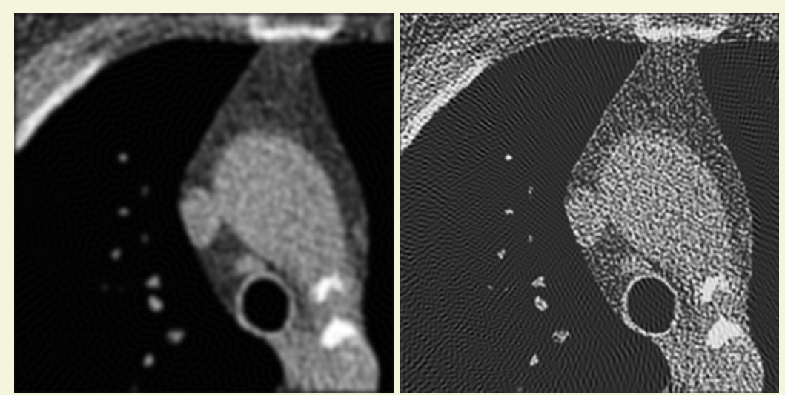
The Low-Pass filter has a smoothing effect on an x-ray CT image. On the other hand, the High-Pass filter shows edges, but it also creates more noise in the image.
Left: The Low-Pass filter has a smoothing effect.
Right: The High-Pass filter shows edges but it creates more noise.
From Interactive Radiology Physics by Mark Hammer
http://xrayphysics.com/index.html

Slide 30
The Discrete Fourier Transform
Named after French Mathematician and Physicist Jean Baptist Joseph Fourier (1768 – 1830)
Thanks to Wikipedia
https://en.wikipedia.org/wiki/Joseph_Fourier

Slide 31
Fourier’s Controversial Claim at the time!
Any continuous periodic signal could be represented as the sum of properly chosen sinusoidal waves.

Slide 32
This illustrates how a signal can be decomposed into sines and cosines.
Synthesize
The original signal (top left) has 16 sample points.
Fourier decomposition (bottom right) of this signal consists of 9 cosines and 9 sines.
Each wave with a different frequency and amplitude.
Decompose

Slide 33
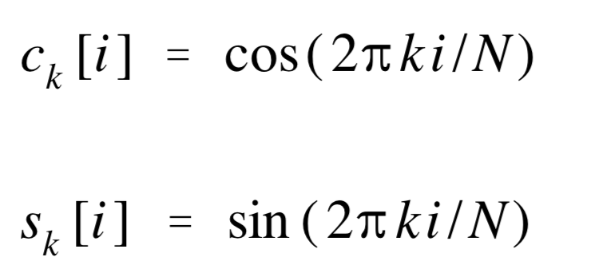
The DFT Basis Functions are generated by the equations:
These form a set of sine and cosine waves with unity amplitude.
The original signal was decomposed into these waves.
These waves were also used to synthesize the original signal.

Slide 34
The cool thing is that this Fourier decomposition works whether the signal is continuous or discrete, and either periodic or aperiodic.
There is an entire family of Fourier Transforms!

Slide 35
Why do we care so much about the Fourier Transform in DSP?
The Fourier Transform is an extremely powerful mathematical tool that allows you to view your signals in a different domain
Signals can be represented in the Time Domain and in the Frequency Domain.
The Fourier Transform is the mathematical relationship between these two representations.
NOTE: A change in one domain results in a change in the other one!

Slide 36
Ok, what about this thing called the Fast Fourier Transform (FFT)?
Fast Fourier Transform (FFT)
Produces the same results as with the DFT
Is incredibly efficient and it can often reduce computation time by hundreds
Makes all DPS techniques possible, period!
Is another method for calculating the DFT.

Slide 37
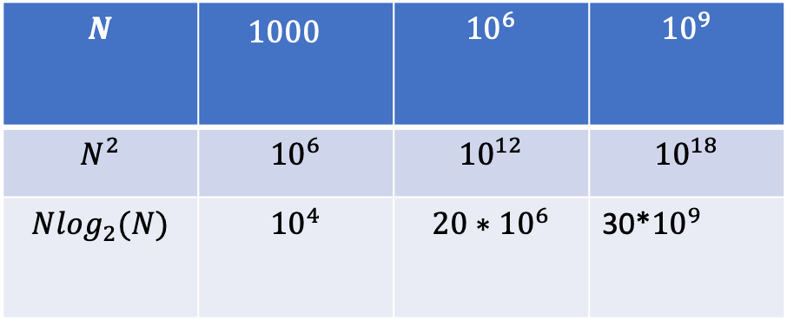
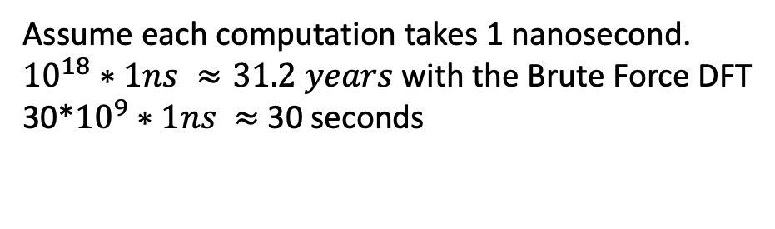
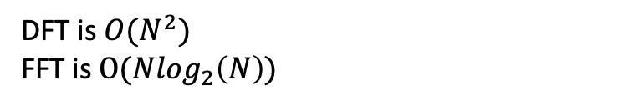
$$N$$ | $${1000}^{}$$ | $${10}^{6}$$ | $${10}^{9}$$
$$N^{2}$$ | $${10}^{6}$$ | $${10}^{12}$$ | $${10}^{18}$$
$$N\log_{2}(N)$$ | $${10}^{4}$$ | $$20∗{10}^{6}$$ | 30*${10}^{9}$
N complex multiplications and N-1 complex additions.
Assume each computation takes 1 nanosecond.
${10}^{18}∗1ns ≈31.2 years$ with the Brute Force DFT
$\text{30∗}{10}^{9}∗1ns ≈$ 30 seconds
DFT is ${O(N}^{2})$
FFT is $O(N\log_{2}\left(N\right))$

Slide 38
What is the take away message here?
Linearity of a system
Impulse Function
Time and Frequency domains in DSP
Convolution

Slide 39
Thank you ☺

Slide 40
The Scientist & Engineer's Guide to Digital Signal Processing, by Stephen W. Smith
Wikipedia
The FFT Fundamentals and Concepts, by Robert W. Ramirez.
The Interactive Radiology Physics by Mark Hammer
http://xrayphysics.com/index.html

